Slide 1
Infinite Campus and CUES
Lisa Keeter, KSIS Service Manager
Office of Education Technology
1

Slide 2
New Student Workflow
New Student
Use Student Locator
Create Enrollment
OneRoster to RapidIdentity
Create credentials and email address
OneRoster Identity Management
Populates Contact Email
Triggers Student Account Automation
2
Lisa Keeter
Notes:
No one has implemented the Identity Management option to populate contact email in production yet.

Slide 3
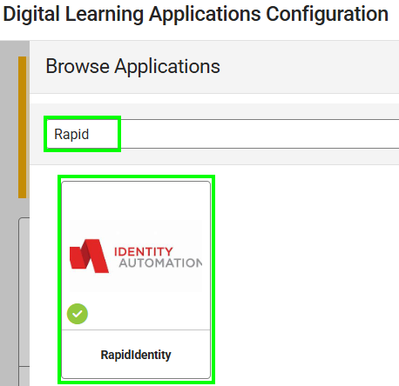
Supported Identity Automation Application
Tool Search: Digital Learning Applications Configuration
See CUES Infinite Campus Setup OneRoster
Connection for step-by-step directions.
Select the RapidIdentity tile to create a
connection that allows the writeback of email
address for students and teachers.
Direct SQL access is no longer needed.
  If created, submit a case to delete the service
  account for Identity Automation.
3
Lisa Keeter
Notes:
If you created a OneRoster connection for CUES before the supported Identity Automation tile was available in late June, a new application needs to be created. This application supports the writeback of email address for students and teachers.
Early adopters and Phase 1 districts were asked to create a SQL service account for Infinite Campus. This is no longer needed. Please request that the account be deleted.

Slide 4
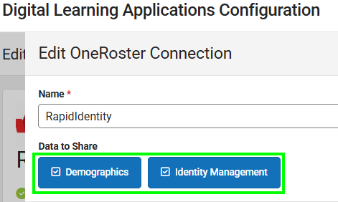
Generate OneRoster 1.2 Connection
CUES requires OneRoster 1.2.
Enable Data to Share Demographics and Identity Management.
Share the connection information with RapidIdentity via CUES Infinite Campus Information.
4
Lisa Keeter

Slide 5
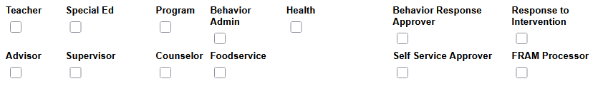
OneRoster 1.2 Demographics Includes
Student: A person with an Enrollment in the active year. Enrollments marked as No Show are not returned.
Teacher: A person with a District Assignment in the active year with a role of Teacher marked.
Aide: A person with a District Assignment in the active year with one of these roles marked.
DistrictAdministrator: A staff member with security clearance to create other staff members and perform system administrative duties.
5
Lisa Keeter
Notes:
OneRoster 1.2 only includes staff with specific roles marked on District Assignment records for the active year.
Aide included persons if the role Special Ed, Program, Behavior Admin, Health, Behavior Response Approver, Response to Intervention, Advisor, Supervisor, Counselor, Foodservice, Self Service Approver, or FRAM Processor is checked.

Slide 6
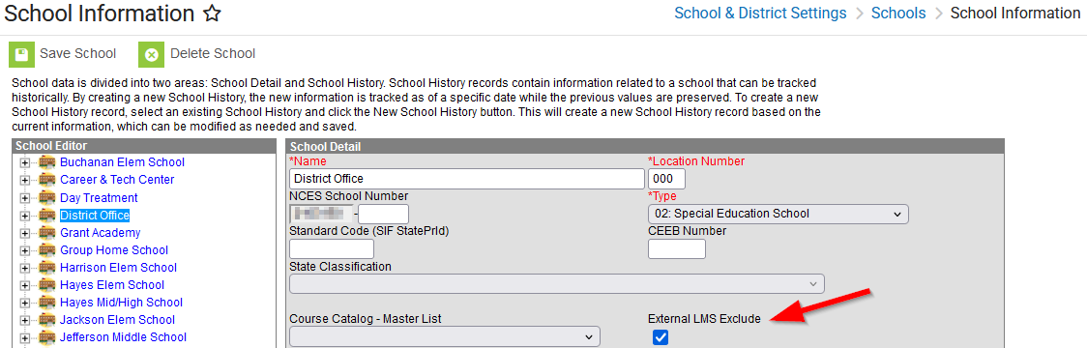
Exclude data from OneRoster
See the External LMS Exclude (Digital Learning Applications) article for details.
6
Lisa Keeter
Notes:
If the district has schools or calendars that should not be shared by OneRoster to any vendor, set the External LMS Exclude indicator at the highest applicable level as it applies to all records below it in the hierarchy.
For example, if a school is used to track homeschool students setting External LMS Exclude on the school will prevent all calendars, courses and enrollments in that school from being sent via OneRoster API. See the External LMS Exclude (Digital Learning Applications) article for more information.

Slide 7
Create SAML - SSO Connection to RapidIdentity
Existing connection for Microsoft or Google may remain.
Create a connection to RapidIdentity for testing so it’s ready to use for new users and to switch local authentication users to SAML.
  Create a test user account to use the RapidIdentity connection.
Switching Campus authentication to RapidIdentity should be planned with the RapidIdentity implementation engineer and the district CUES team.
  Early Adopters have not done this yet.
7
Lisa Keeter
Notes:
If active configurations exist for Microsoft or Google, there is no need to change them.
Please work with your RapidIdentity implementation engineer or RapidIdentity system administrator to assist with this process. An exchange of information is required.

Slide 8
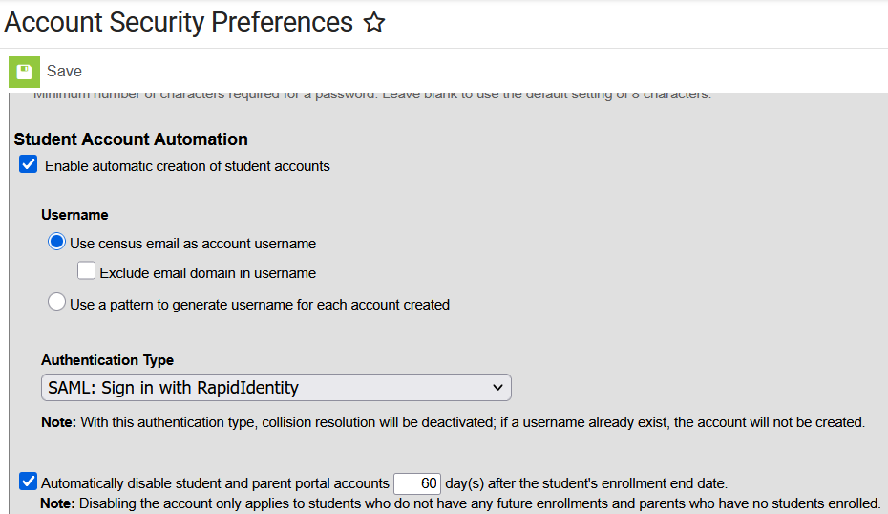
Enable Student Account Automation
8
Notes:
Campus functionality can
- create user accounts for students that do not have one when the OneRoster Identity Management option populates the email address.
- disable student and parent portal accounts after the student’s enrollment end date. The district selects the number of days.

Slide 9
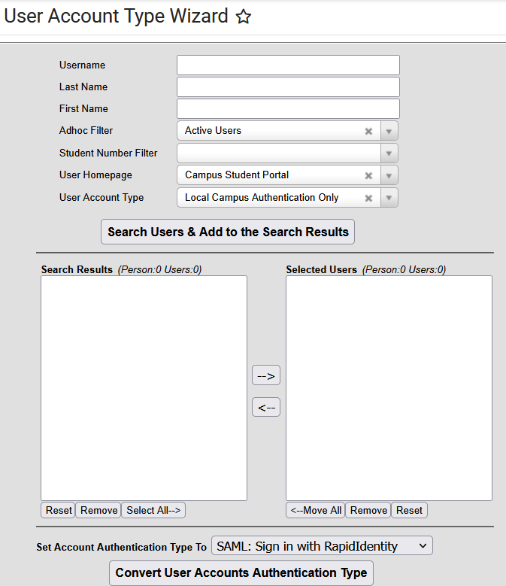
User Account Type Wizard
Change the authentication type of multiple active users
Filter by
  Username
  Last Name
  First Name
  Adhoc filter
  User Homepage
  User Account Type
Search results are cumulative
Select users from search results
Select the desired Authentication Type
See the Knowledgebase article for more details.
9
Notes:
When the district CUES team determines it is time to use SSO to RapidIdentity, the User Account Type Wizard can change a subset of users from one authentication type to using various filter options to select the users. The wizard only returns active users.
A maximum of 9,000 results can be returned from a single search, and the wizard can process at most 9000 results. Adhoc filters can be used to limit the search as needed.
This process does not change the username to the email address. RapidIdentity is storing the existing Campus username so that Single Sign On with the email address will match to the Campus user account.

Slide 10
What about staff?
CUES is using Enterprise ERP (formerly Munis) as the data source for creating RapidIdentity credentials and email address for new staff.
OneRoster Identity Automation only populates the email address of students and teachers.
Campus is developing an API integration with Enterprise ERP. It may be a few years before it is available for Kentucky version.
10
Lisa Keeter

Slide 11
Dig Deeper
Check with your district CIO to see what group your district is in.
All districts will implement RapidIdentity by June 2026.
Visit the KETS CUES Resource Hub for additional information.
11
Lisa Keeter
Notes:
Questions is we have time.

