Slide 1
Stepping up to lead Sparx Reader
September 2024

Slide 2
Aims
To understand the core tenets of Sparx Reader, so that you are able to communicate the central messages to key stakeholders in your school.
To know the best routes for training staff and getting pupils set up with Sparx Reader, so that you can develop a solid early-implementation strategy that will endure.
To pre-empt any pinch points and challenges, so that you are confident in tackling any issues.
To understand how Sparx Reader fits into your school’s pre-existing reward and consequence policies, so that there is consistency with all homework.
To create a list of practical to-dos, so that your life as Sparx Reader Lead is as smooth as possible.

Slide 3
Stepping Up to Lead Sparx Reader
01
02
03
04
05
Understanding Sparx Reader: the ‘headlines’
Getting your team and your students set up
Pre-empting challenges and misconceptions
Rewarding, supporting and challenging students
Getting help and support with Sparx Reader

Slide 4
Setting the scene
The life of an English teacher
Reading demands at secondary level
Reading habits in young people
Reading homeworks
Reading for pleasure

Slide 5
01 - The Sparx Reader ‘headlines’
Reader Lead Practicalities:
Keep the Sparx Reader messaging simple: practise careful, meaningful and attentive reading, regularly.
Gives pupils the chance to practise careful, meaningful and attentive reading, regularly.
Lets pupils know when they have been reading successfully.
Levels the playing field for readers of all abilities.
Gives teachers unparalleled visibility into time spent, amount read and accuracy.

Slide 6
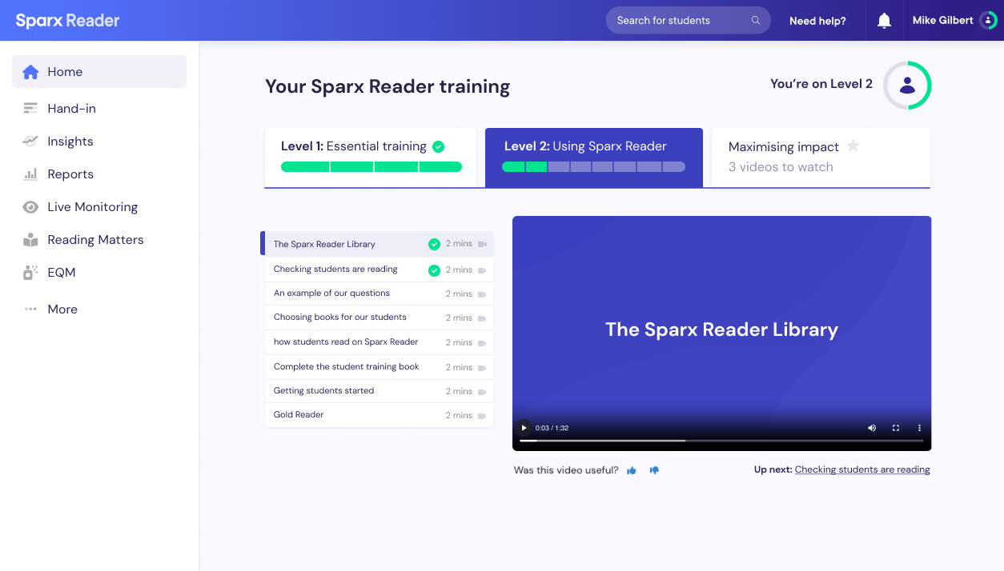
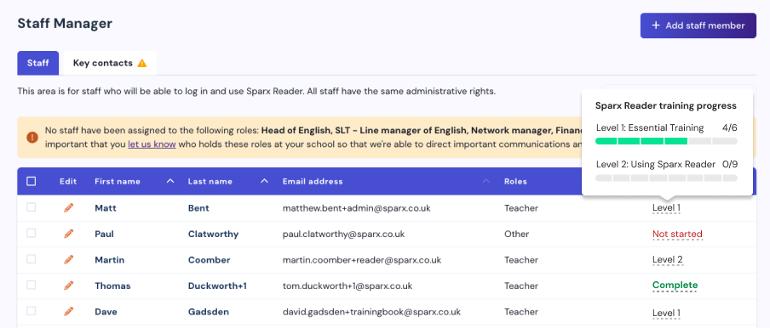
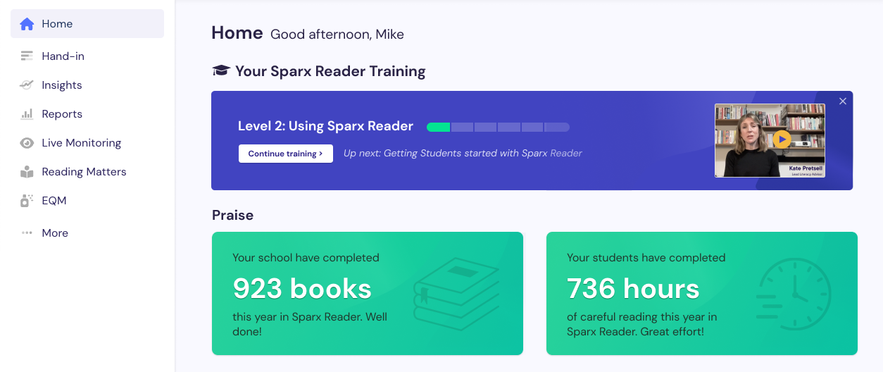
02 - Getting teachers set up
Reader Lead Practicalities:
Keep the Sparx Reader messaging simple: practise careful, meaningful and attentive reading, regularly.
Ensure your whole team has watched the training videos.
Ensure your whole team has watched the essential training videos.

Slide 7
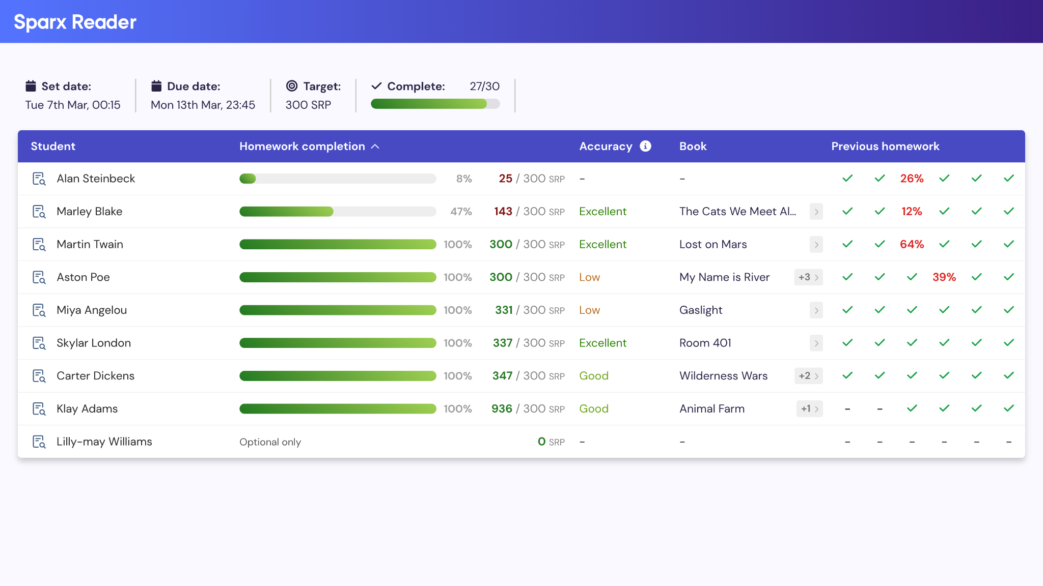
02 - Getting teachers set up
Reader Lead Practicalities:
Keep the Sparx Reader messaging simple: practise careful, meaningful and attentive reading, regularly.
Ensure your whole team has watched the training videos.
Decide on the department-wide approach to using the hand in page.
Discuss your department-wide strategy for showing classes the hand in page every lesson:
-Who to focus on, and why?
-What kinds of conversations should be had?
Insist on 100% completion.
Leaderboards: at class, year group & school levels.

Slide 8
02 - Getting students set up
Reader Lead Practicalities:
Keep the Sparx Reader messaging simple: practise careful, meaningful and attentive reading, regularly.
Ensure your whole team has watched the training videos.
Decide on the department-wide approach to using the hand in page.
Book computer rooms for tests/first Sparx experience.
Update Heads of Year.
Make sure that any year groups/individuals new to Sparx Reader have a computer room for their tests.
Report issues with access/ device availability.
Devote lesson time to familiarisation.
Insist on 100% completion.
Use start of year assemblies to set expectations.
Get Heads of Year involved.
Student-facing explainer video.

Slide 9
02 - Getting parents set up
Reader Lead Practicalities:
Keep the Sparx Reader messaging simple: practise careful, meaningful and attentive reading, regularly.
Ensure your whole team has watched the training videos.
Decide on the department-wide approach to using the hand in page.
Book computer rooms for tests/first Sparx experience.
Update Heads of Year.
Communicate with all parents.
Use our email/letter templates to communicate with parents.
Keep the messaging the same with parents as you would with students: to practise careful, meaningful and attentive reading, regularly.
Parents can see their children’s homework via the Parent Portal link in the Sparx Maths weekly email.
Use our parent-facing videos to educate parents.
Consider setting up a system for keeping parents updated.

Slide 10
03 - Pre-empting challenges and misconceptions
Reader Lead Practicalities:
Keep the Sparx Reader messaging simple: practise careful, meaningful and attentive reading, regularly.
Ensure your whole team has watched the training videos.
Decide on the department-wide approach to using the hand in page.
Book computer rooms for tests/first Sparx experience.
Update Heads of Year.
Communicate with all parents.
Be ready with answers to common questions.
Early challenges.
Skim reading.
SRP to minutes conversion.
Explain the accuracy measure.
Struggling readers.
Activity Timeline conversations.
Rewards & consequences.
Rationale for offering four books.
Sparx Reader does not replace the school library!
SLT backing.

Slide 11
04 - Rewarding, supporting and challenging students
Reader Lead Practicalities:
Keep the Sparx Reader messaging simple: practise careful, meaningful and attentive reading, regularly.
Ensure your whole team has watched the training videos.
Decide on the department-wide approach to using the hand in page.
Book computer rooms for tests/first Sparx experience.
Update Heads of Year.
Communicate with all parents.
Be ready with answers to common questions.
Check completion statistics daily.
Check completion statistics daily.
Support struggling students at first.
Dedicated catch-ups.
Leaderboards.
Activity Timeline.
Identify those who are repeatedly failing to complete their homework.
Weekly/termly celebrations.

Slide 12
05 - Help and support
Reader Lead Practicalities:
Keep the Sparx Reader messaging simple: practise careful, meaningful and attentive reading, regularly.
Ensure your whole team has watched the training videos.
Decide on the department-wide approach to using the hand in page.
Book computer rooms for tests/first Sparx experience.
Update Heads of Year.
Communicate with all parents.
Be ready with answers to common questions.
Check completion statistics daily.
Familiarise yourself with the support centre.
Complete the training videos.
For all and any questions you might have, visit the Support Centre for a whole range of articles, e.g.:
‘Why doesn’t Sparx Reader have much non-fiction?’
‘Students and book choice’
‘Books with mature themes’
‘How does Sparx Reader support lower-attaining students?’
You can contact us directly in the support centre too.
Book in time with your dedicated success coach.
Watch Donal Hale at Trinity Academy Leeds talk about how he implemented Sparx Reader.
Browse the other webinars and the case studies for more detail on lots of topics.
Reading Matters.

Slide 13
Reader Lead Practicalities:
Keep the Sparx Reader messaging simple: practise careful, meaningful and attentive reading, regularly.
Ensure your whole team has watched the training videos.
Decide on the department-wide approach to using the hand in page.
Book computer rooms for tests/first Sparx experience.
Update Heads of Year.
Communicate with all parents.
Be ready with answers to common questions.
Check completion statistics daily.
Familiarise yourself with the support centre.

