Slide 1
Notes
Start your slides with this slide show, before the actual session starts
These slides can be edited as needed
The slides can be played with timings (30 sec) before the session starts to orientate students [Note: this may prevent you from doing something else on your computer]

Slide 2
Welcome to the class
We will be starting at 08:00
The netiquette rules/communication / interaction rules are:
If you have questions, please type in the chat
Questions will be answered by Assistant lecturers
Participate in all polls done
Have

Slide 3
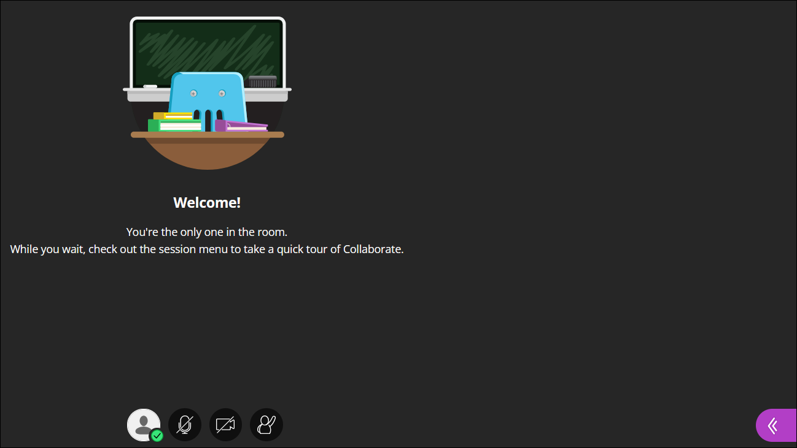
We will be starting at 08:00
Collaborate panel
Share options
Close panel
Chat
Chat
Settings
Participants & signal strength
Change your settings
Microphone
Video
Raise hand
Opens Collaborate panel
More options
Notes:
To help throughout with vidual cues

Slide 4
We will be starting at 08:00
Rules of Engagement
Ensure your connectivity signal is 3 bars and above.
Keep your video off throughout the session.
Turn off all other applications on your device (email etc.) This will improve the performance of the software.
Adjust the volume on your phone or computer speakers to ensure you can hear well.
Use the chat function to ask questions.
More options
Notes:
To help throughout with vidual cues

Slide 5
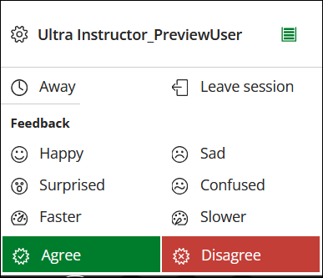
We will be starting at 08:00
More options
Notes:
To help throughout with vidual cues

Slide 6
We will be starting at 08:00
During a session the View controls appear for your screen with descriptions when you mouse over them
Close Zoom in Zoom out Actual size
More options
Notes:
To help throughout with vidual cues

